Slide 1

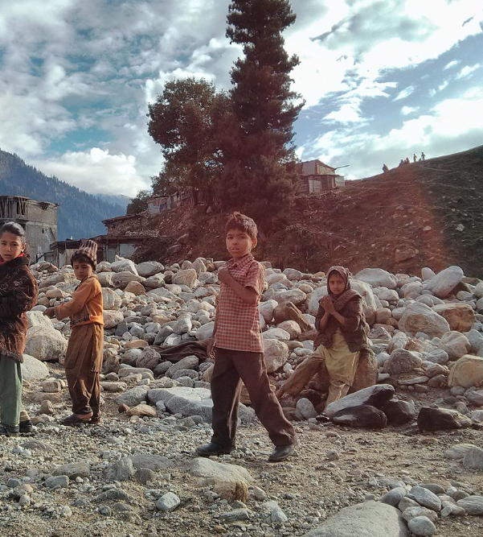
Poverty in Pakistan
Challenges, Causes, and Solutions
Presented by:mehak fatima

Slide 2
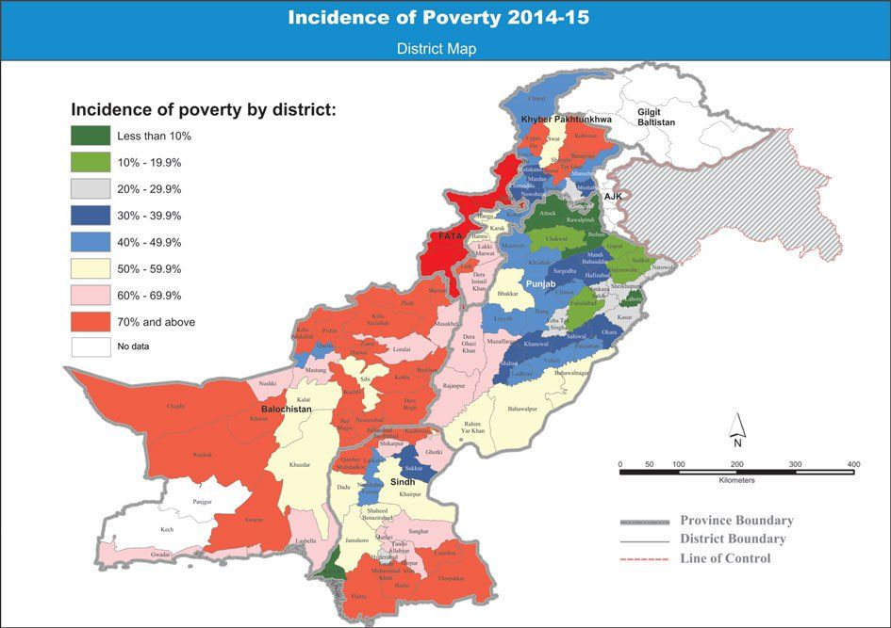
Overview of Poverty in Pakistan
Pakistan has one of the highest poverty rates in South Asia.
About 24-30% of the population lives below the poverty line.
Significant rural-urban divide in poverty rates.

Slide 3
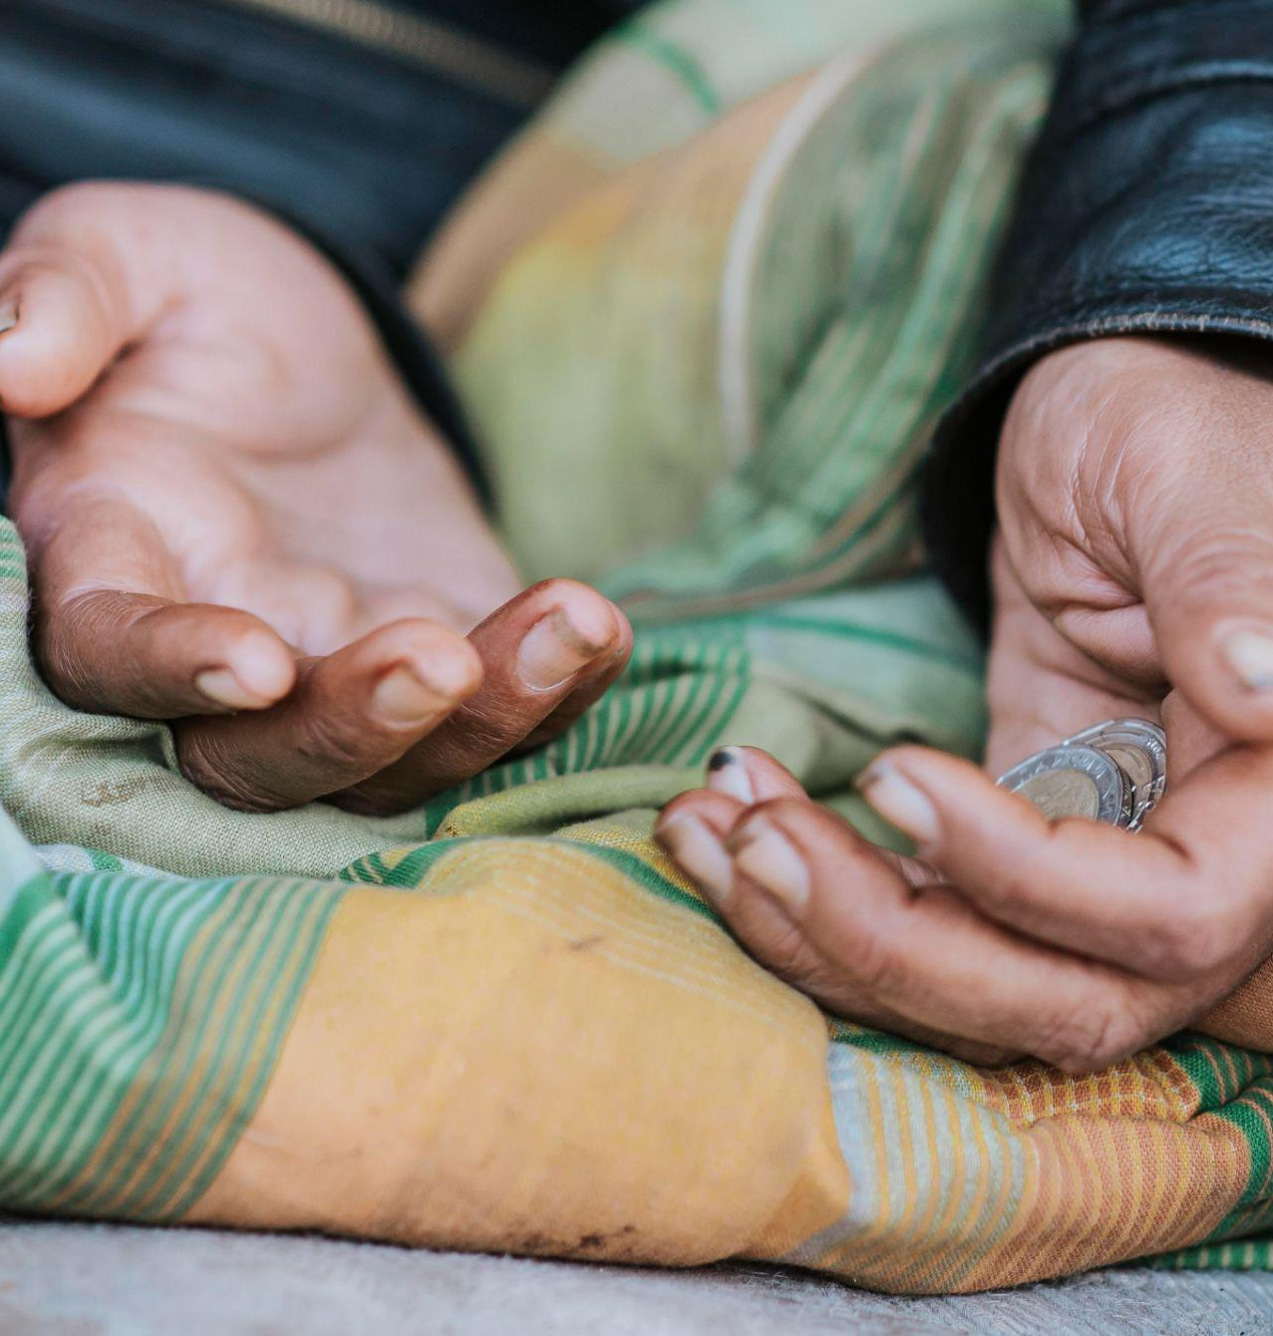
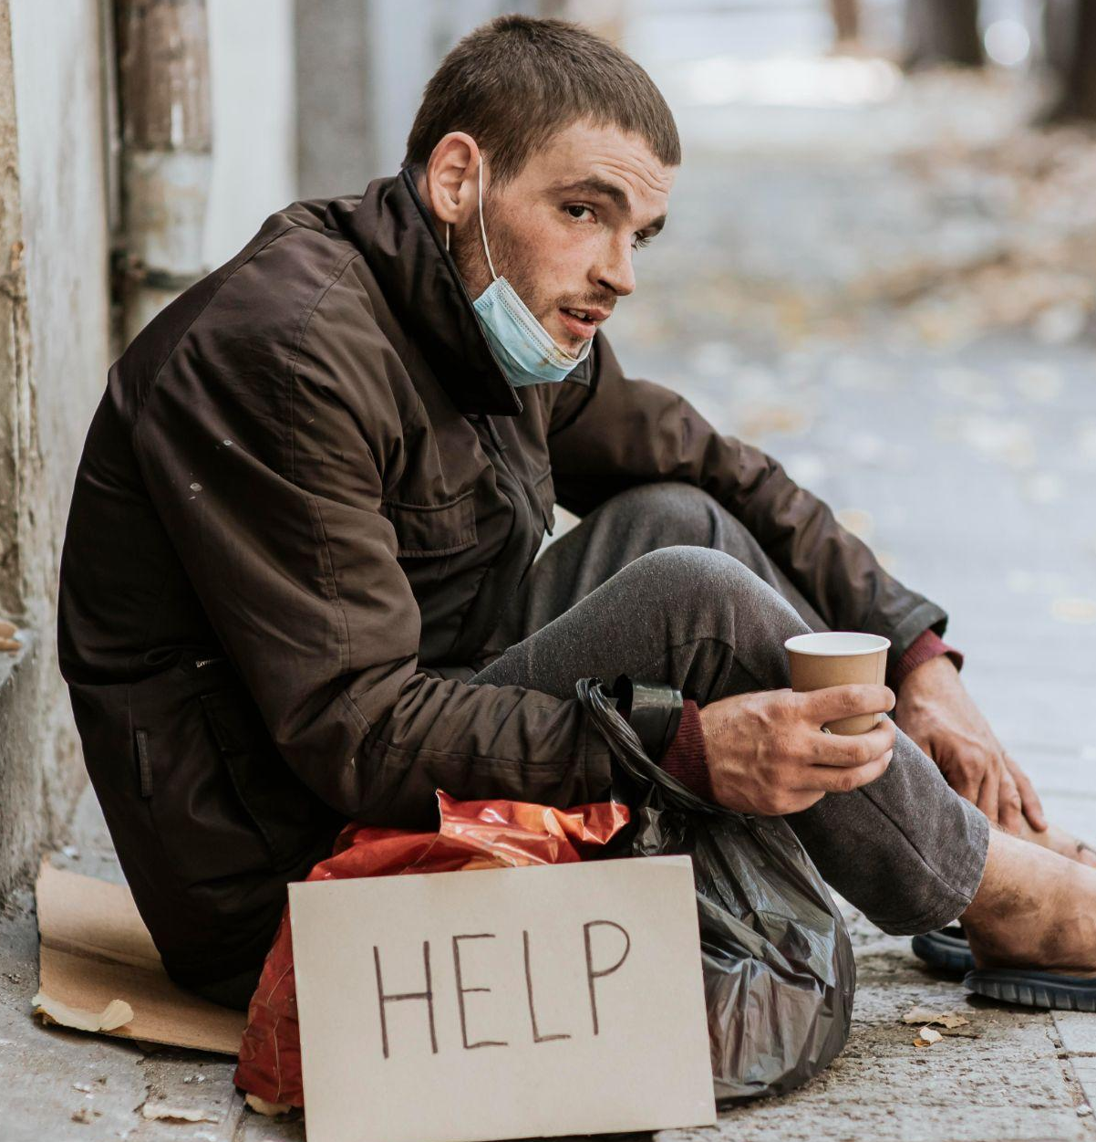
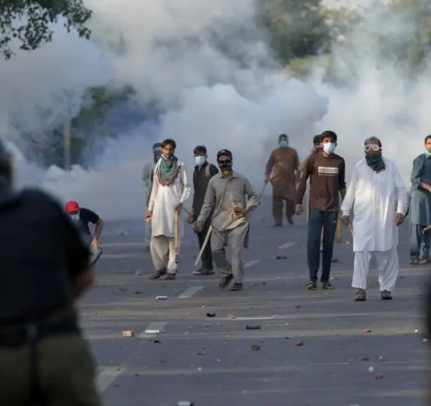
Causes of Poverty
Economic Instability
Social Issues
Political Factors
Inflation, unemployment, and low wages
Illiteracy, health care access, and gender inequality.
Corruption, poor governance, lack of social safety nets.

Slide 4
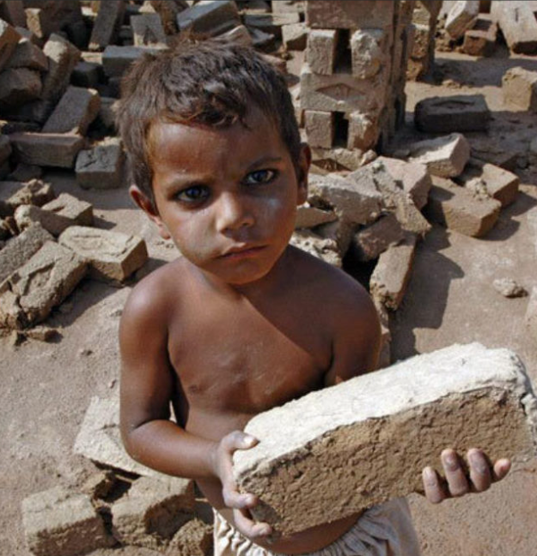
Impact of Poverty
Health
High infant mortality, malnutrition.
Education
Low school enrollment, high dropout rates.
Child Labor
Many children forced to work due to family poverty.
Crime & Social Unrest
Poverty often leads to increased
crime and unrest.

Slide 5
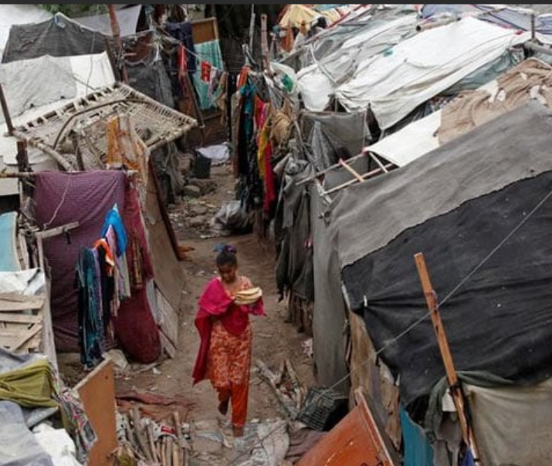
Poverty in Rural vs Urban Areas
Rural areas face higher poverty rates compared to urban centers.
Lack of infrastructure, education, and employment opportunities in rural areas.
Urban areas also face poverty, but there’s better access to services.

Slide 6
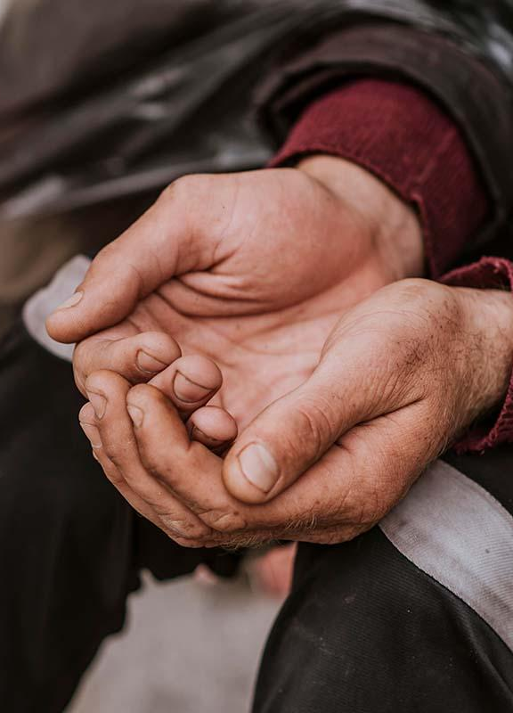
Role of Education in Reducing Poverty
Education is key to lifting people out of poverty.
Pakistan's literacy rate is around 58% with significant gender disparity.
Need for more investment in schools, vocational training, and female education.

Slide 7
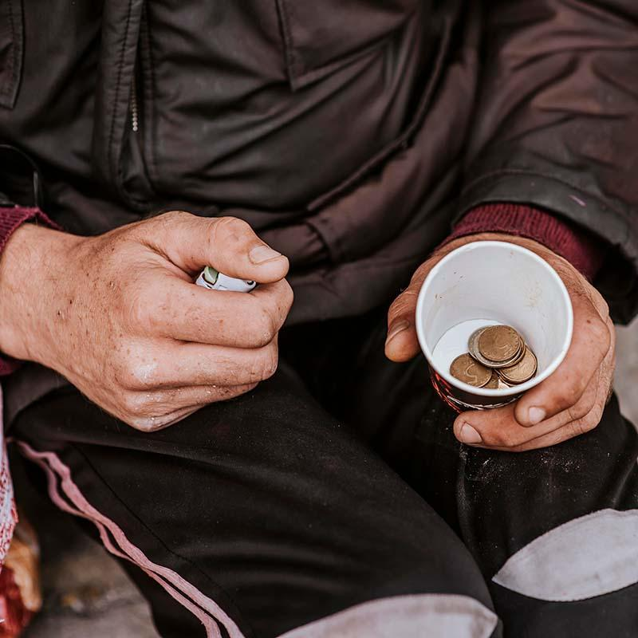
Government Initiatives
Ehsaas Program:
Comprehensive program aimed at poverty alleviation.
Benazir Income Support Program (BISP): Provides financial assistance to low-income families.
Challenges: Implementation issues, corruption, lack of resources.

Slide 8
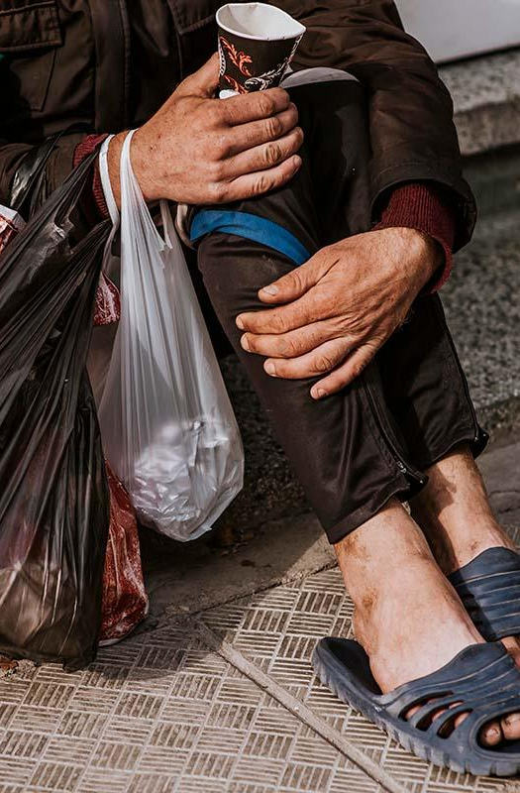
NGOs play a significant role in providing education, healthcare, and relief.
International organizations such as the World Bank, IMF, and UNICEF contribute financially and through various projects.
Partnerships between government, NGOs, and international bodies.
Role of NGOs and International Aid

Slide 9
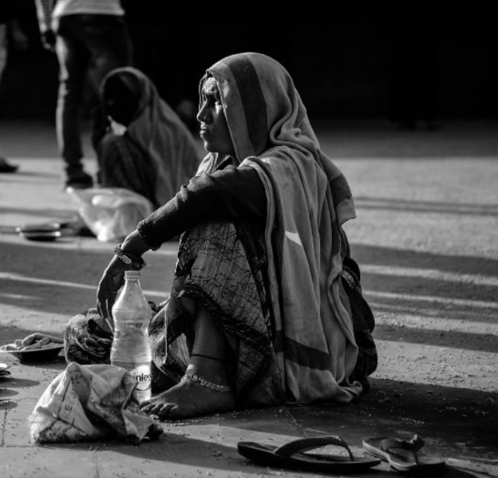
Challenges in Addressing Poverty
Political instability and corruption.
Economic inequality and poor governance.
Environmental challenges like floods and droughts exacerbate poverty.
Population growth leading to greater demand for limited resources.

Slide 10
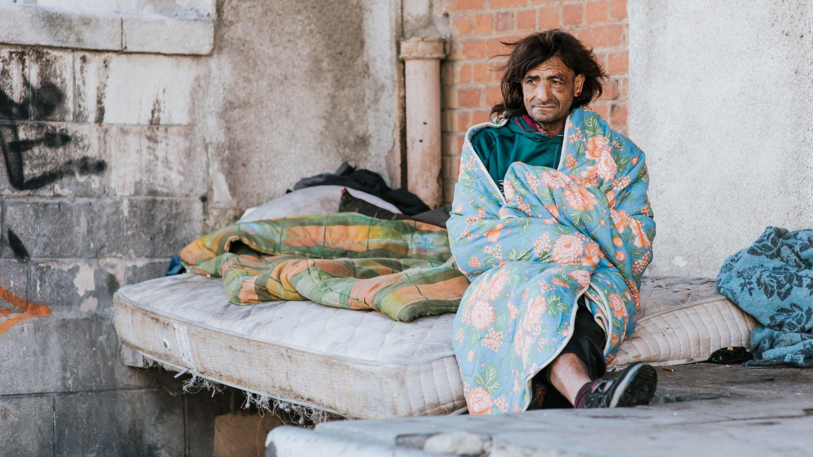
Solutions to Combat Poverty
Invest in education and skill development.
Strengthen social safety nets and increase access to healthcare.
Promote economic growth through job creation and entrepreneurship.
Gender empowerment: involve women in the workforce and decision-making.

Slide 11
THANKS
Poverty remains a major challenge in Pakistan, but with strategic planning and commitment, it can be addressed.
Both short-term relief and long-term sustainable development are needed.
Collaboration between government, NGOs, and international partners is key.

